Slide 1
Welcome to Marketing Management
Dr. Cecilia Ruvalcaba
BUSI 107 Week 10, Day 3

Slide 2
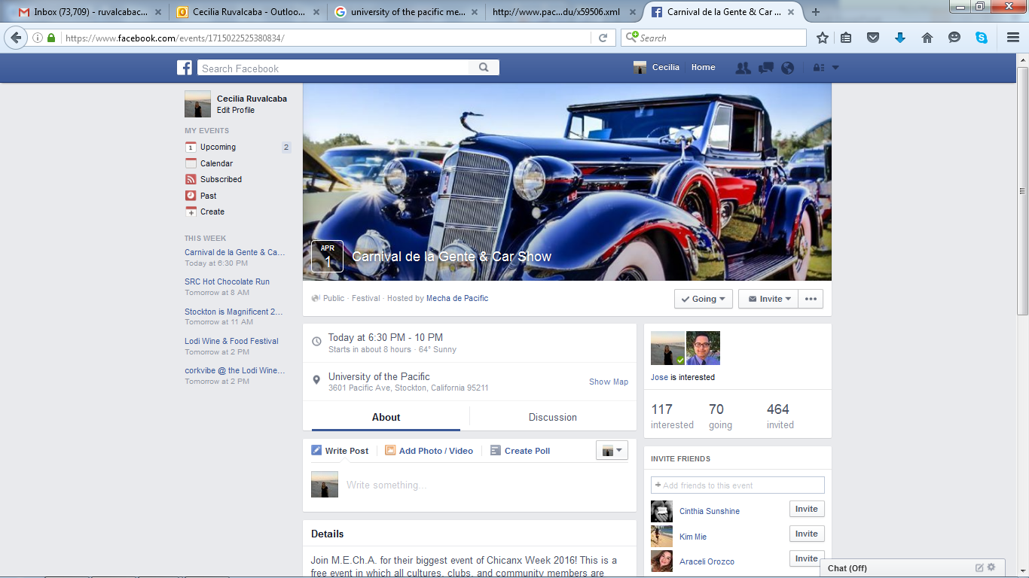
Join M.E.Ch.A. for their biggest event of Chicanx Week 2016! This is a free event in which all cultures, clubs, and community members are welcome. M.E.Ch.A. invites you to know a little bit more about our organization and have fun! Location: Car Show - Stagg Way Carnival de la Gente - WPC Lawn

Slide 3
Delivering Value Through Marketing Channels Cont…

Slide 4


Channel Strategy Considerations
Distribution coverage:
Intense- Achieve mass market selling
Selective- Work with selective intermediaries.
Exclusive- Work with one or few intermediaries.
Degree of control:
Channel Power (producers or intermediaries)
Brand Equity
Total distribution cost
Transportation, Order processing, Cost of lost business, Inventory carrying costs, Packaging, Materials handling.
Channel flexibility- ability to adapt to changing conditions.

Slide 5
Export Price Escalation

Slide 6
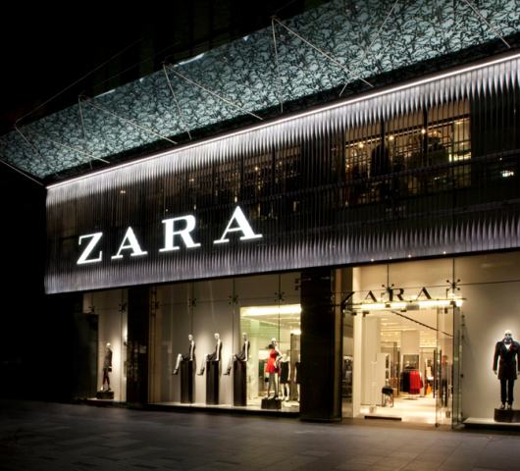

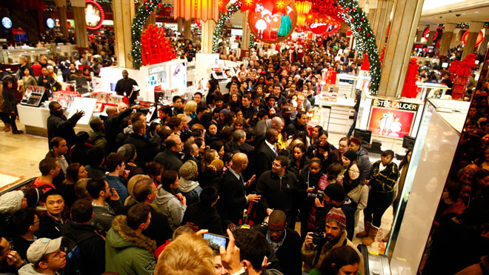

Channel Selection
Assume Full Distribution Activity
vs.
Depending on Intermediaries
Switching Costs
Brand

Slide 7
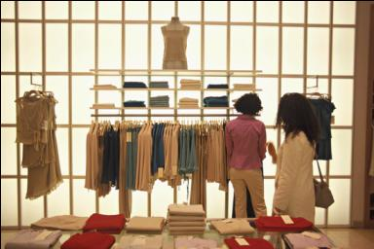
Just In Time (JIT) System
Reduced lead time
Increased product availability and lower inventory investment

Slide 8
Relationship Management
Strategic Relationships
Mutual Trust
Open Communications
Common Goals
Interdependence
Credible Commitments

Slide 9
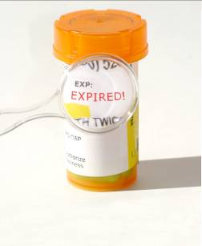
Gray Market Issues
Dilution of exclusivity
Free riding
Damage to channel relationships
Undermining segmented pricing schemes
Reputation and legal liability
Selling drugs out of date leads to lawsuits.
Notes:
•

Slide 10
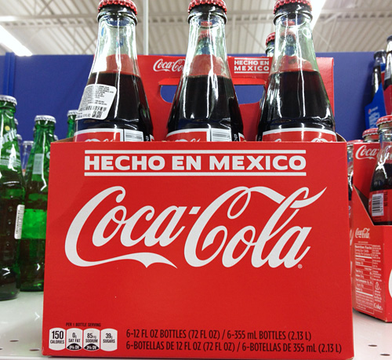
CHANNEL CONFLICT

Slide 11


Take Away for Today
Channel Selection is Key to Product Success!
Manage Relationships to create value!
The Value Conflict
Customer Demand vs. Channel Conflict

Slide 12

Next Class
Marketing Channels & Retail Strategy Cont…

